Slide 1
Project Based Learning -II
Team Details:
Name: Manpreet Singh Goindi
Roll No.: 2210993813
Faculty Coordinator: Kamaldeep sir
:
Chitkara University Institute of Engineering and Technology,
Chitkara University, Punjab

Slide 2
Table of Contents
Introduction
Problem Statement
Technical Details
Key Features
Project Highlights
Bonus Feature(optional)
Conclusion
References/Links used

Slide 3
Introduction
Customer Behavior Analysis: Analyzing purchasing patterns and preferences to enhance customer experience and tailor offerings.
Sales Performance Insights: Monitoring revenue trends and identifying top-selling products to refine sales strategies and customer service.
Operational Optimization: Streamlining inventory management, pricing strategies, and promotional planning to improve efficiency and profitability

Slide 4
Problem Statement
Supermarkets face challenges in understanding customer preferences, managing inventory efficiently, and optimizing sales strategies due to the vast amount of transactional data. Without proper analysis, businesses struggle to identify key sales drivers, predict demand accurately, and implement effective marketing or operational decisions.
This project aims to address these issues by analyzing supermarket sales data to uncover actionable insights, improve revenue generation, and enhance overall business efficiency.

Slide 5
Technical Details
The project will be implemented using the following technologies and libraries:
Python: The core programming language for developing the backend logic.
Matplotlib: A Python library for creating static, animated, and interactive visualizations.
Pandas: A data manipulation library for handling and analyzing structured data.
Numpy: A library for mathematical operations, especially useful for numerical data.
Seaborn: A powerful python library used for data Visualization, built on top of matplotlib.

Slide 6
Key Features
Customer Behavior Analysis: Identifies purchasing patterns to enhance customer experience.
Sales Performance Insights: Tracks revenue trends and top-selling products to improve service and profitability.
Operational Optimization: Enhances inventory management, pricing strategies, and promotional planning.
Data Analysis Tools: Utilizes Pandas and Numpy for data manipulation and numerical analysis.
Visualization: Employs Matplotlib and Seaborn for creating insightful and interactive data visualizations.
Technology-Driven: Python-based implementation for streamlined backend logic and analysis.

Slide 7
Project Highlights
Actionable Insights: Derive meaningful insights from supermarket sales data to support decision-making.
Customer-Centric Approach: Analyze purchasing behavior to tailor services and enhance customer satisfaction.
Data-Driven Optimization: Streamline inventory, pricing, and marketing strategies for increased efficiency.
Profitability: Support businesses in boosting revenue by identifying top-performing products and optimizing operations.
Scalability: A framework that can be extended to include additional data sources or advanced analytics like predictive modeling.

Slide 8
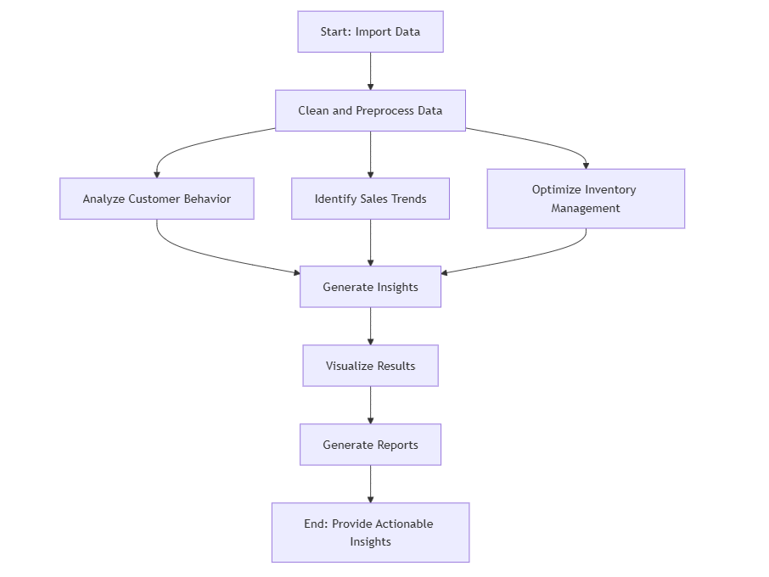
Flowchart
Fig :1

Slide 9
Bonus Feature(optional)
Predictive Analysis: Forecast future sales trends and demand, helping in better inventory and resource planning.
Market Basket Analysis: Identify frequently purchased product combinations for optimized cross-selling and upselling strategies.
Interactive Dashboards: Provide real-time data visualizations for better decision-making and easier reporting.
Customer Segmentation: Classify customers based on purchasing behavior for targeted marketing and personalized offers.
Anomaly Detection: Spot irregular sales trends (unexpected dips or spikes) to quickly address potential issues or opportunities.

Slide 10
Conclusion
Optimized Operations and Sales: The project enhances business efficiency by using data analysis tools to streamline customer behavior analysis, inventory management, and sales performance tracking.
Informed Decision Making: By providing predictive insights and real-time visualizations, the project empowers supermarkets to make data-driven decisions that improve profitability and customer engagement.

Slide 11
References/Links used
Youtube link for seaborn –
https://www.youtube.com/watch?v=DWVLRhnuGqI&t=369s
Chatgpt-
www.chatgpt.com
W3schools link used for understanding library-
https://www.w3schools.com/python/matplotlib_intro.asp

Slide 12


